Slide 1

Number plate detection

Slide 2
Introduction
Our project aims to detect the number plate and extract the registration number of a vehicle in real-time using machine learning.
Number plate detection has many use cases
Government can use it to detect number plates of people breaking rules and fine them.
Buildings can detect the numbers to maintain record of vehicles entered.
Toll plazas can automate toll collection process, Etc.

Slide 3
Dataset
The data has been downloaded from below link
https://public.roboflow.com/object-detection/license-plates-us-eu
It contains over 350images of cars with number plates
For text recognition we use the below dataset which contains 1555 images with text
https://www.kaggle.com/datasets/ipythonx/totaltextstr

Slide 4
Objective
The objective of this project is to create a model which can detect and extract text from number plate.
The model should be able to detect it properly while should be able to do it all in real-time.

Slide 5
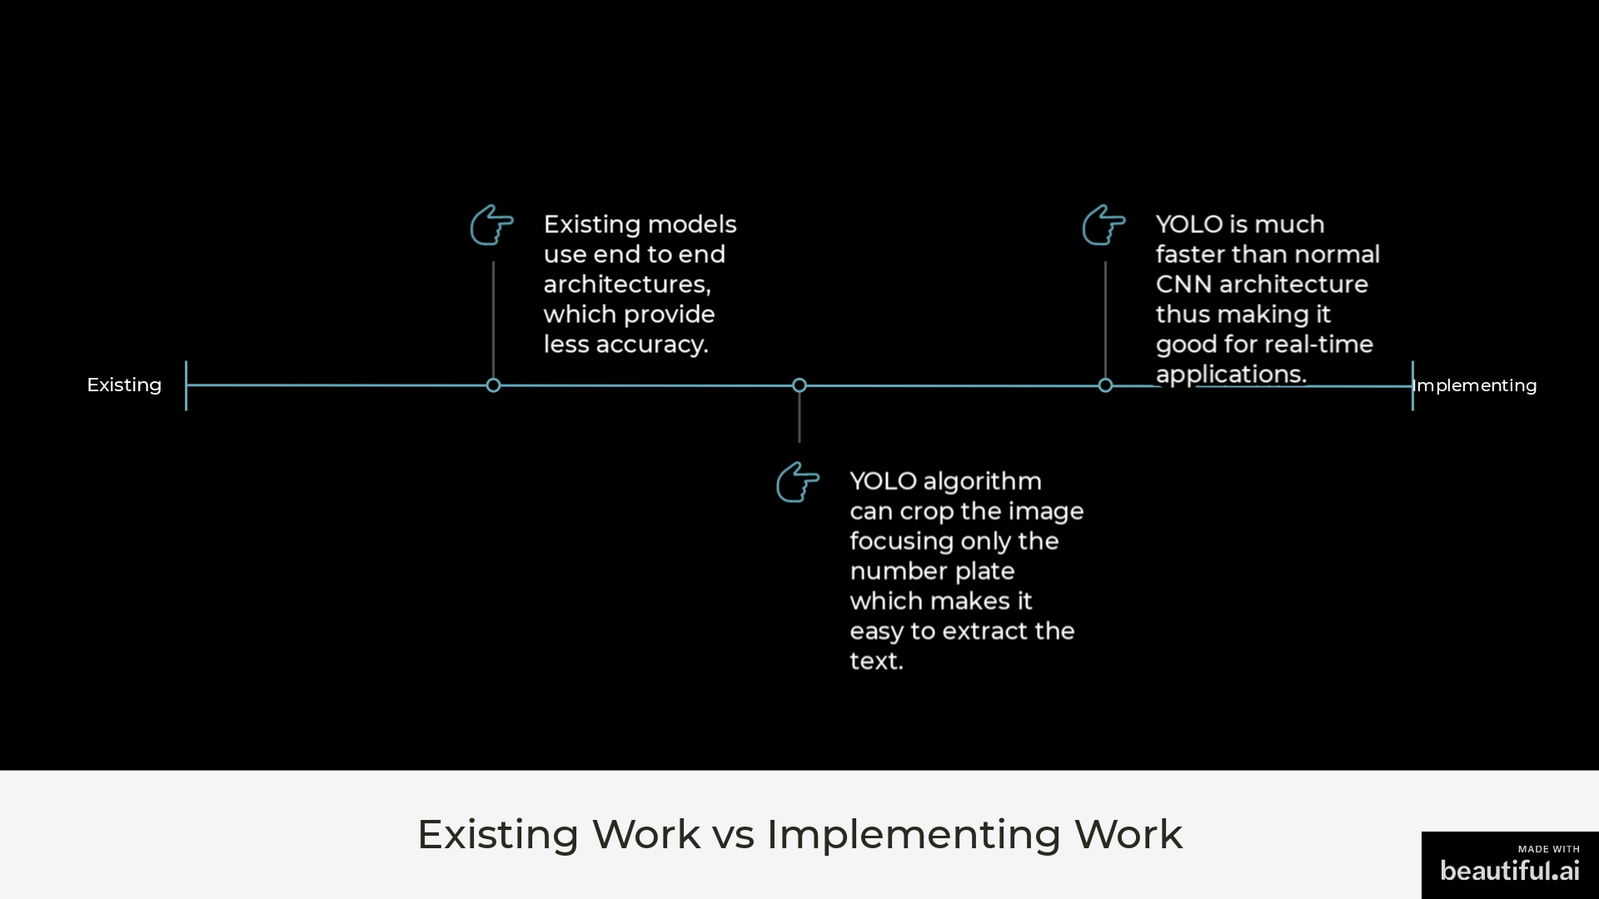
Existing work
Existing models use end to end architectures, which provide lesser accuracy
YOLO algorithm can crop the image focusing only the number plate which makes it easy to extract the text
YOLO is much faster than normal Cnn architecture thus making it good for real-time applications

Slide 6
Implementation steps
Data loading
Data preprocessing
Resize
Grayscale conversion
Yolo application to find number plate coordinates
Image cropping using those coordinates
Model to perform character segmentation
Model training to extract text
Text extraction from cropped images

Slide 7
Models
2 ML models will be used
Yolo to detect number plate
Yolo for character segmentation

Slide 8
Methodology - yolo
YOLO (You Only Look Once) is an object detection algorithm based on convolutional neural networks (CNNs).
It divides the input image into a grid of cells, and the CNN is applied to each cell to predict the probability of an object's presence and its bounding box coordinates.
The algorithm uses a single neural network to make object predictions and can detect multiple objects in real-time.
It is known for its speed, efficiency, and accuracy and is used in various applications, including self-driving cars, surveillance, and robotics.
There are several versions of YOLO, each with its own improvements and optimizations.
YOLO is widely used in computer vision and machine learning for object detection tasks.

Slide 9
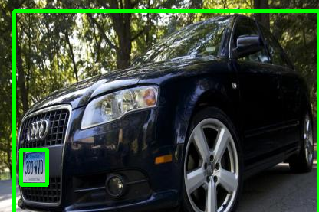
Methodology - yolo for number plate detection
The YOLO model is trained on the number plate detection data.
With in 10 epochs, the model has shown very good results.
One example of the results is shown aside.

Slide 10
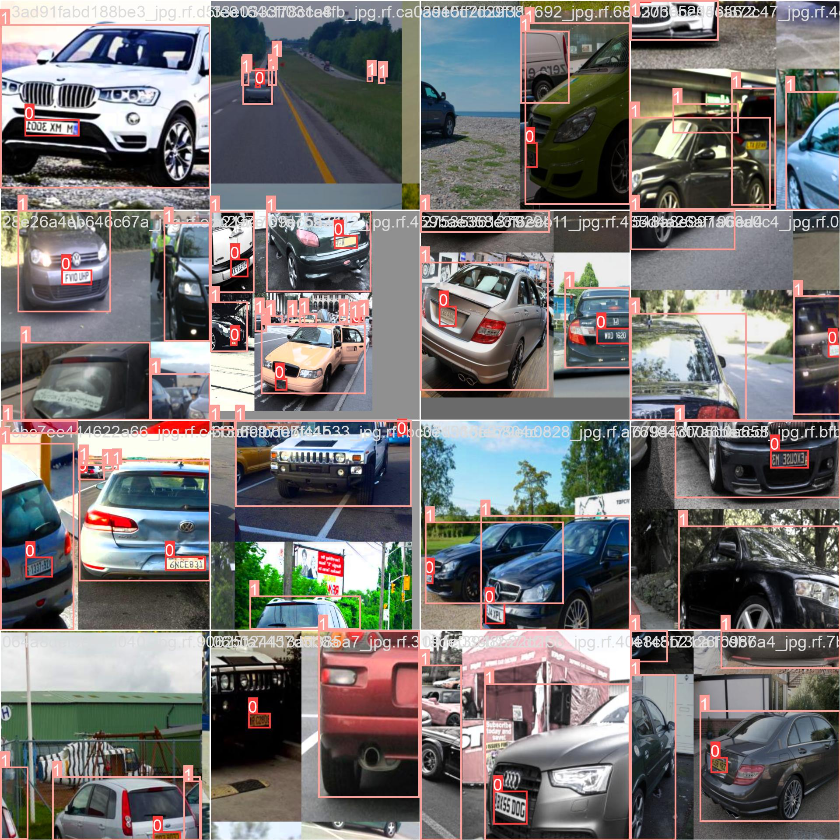
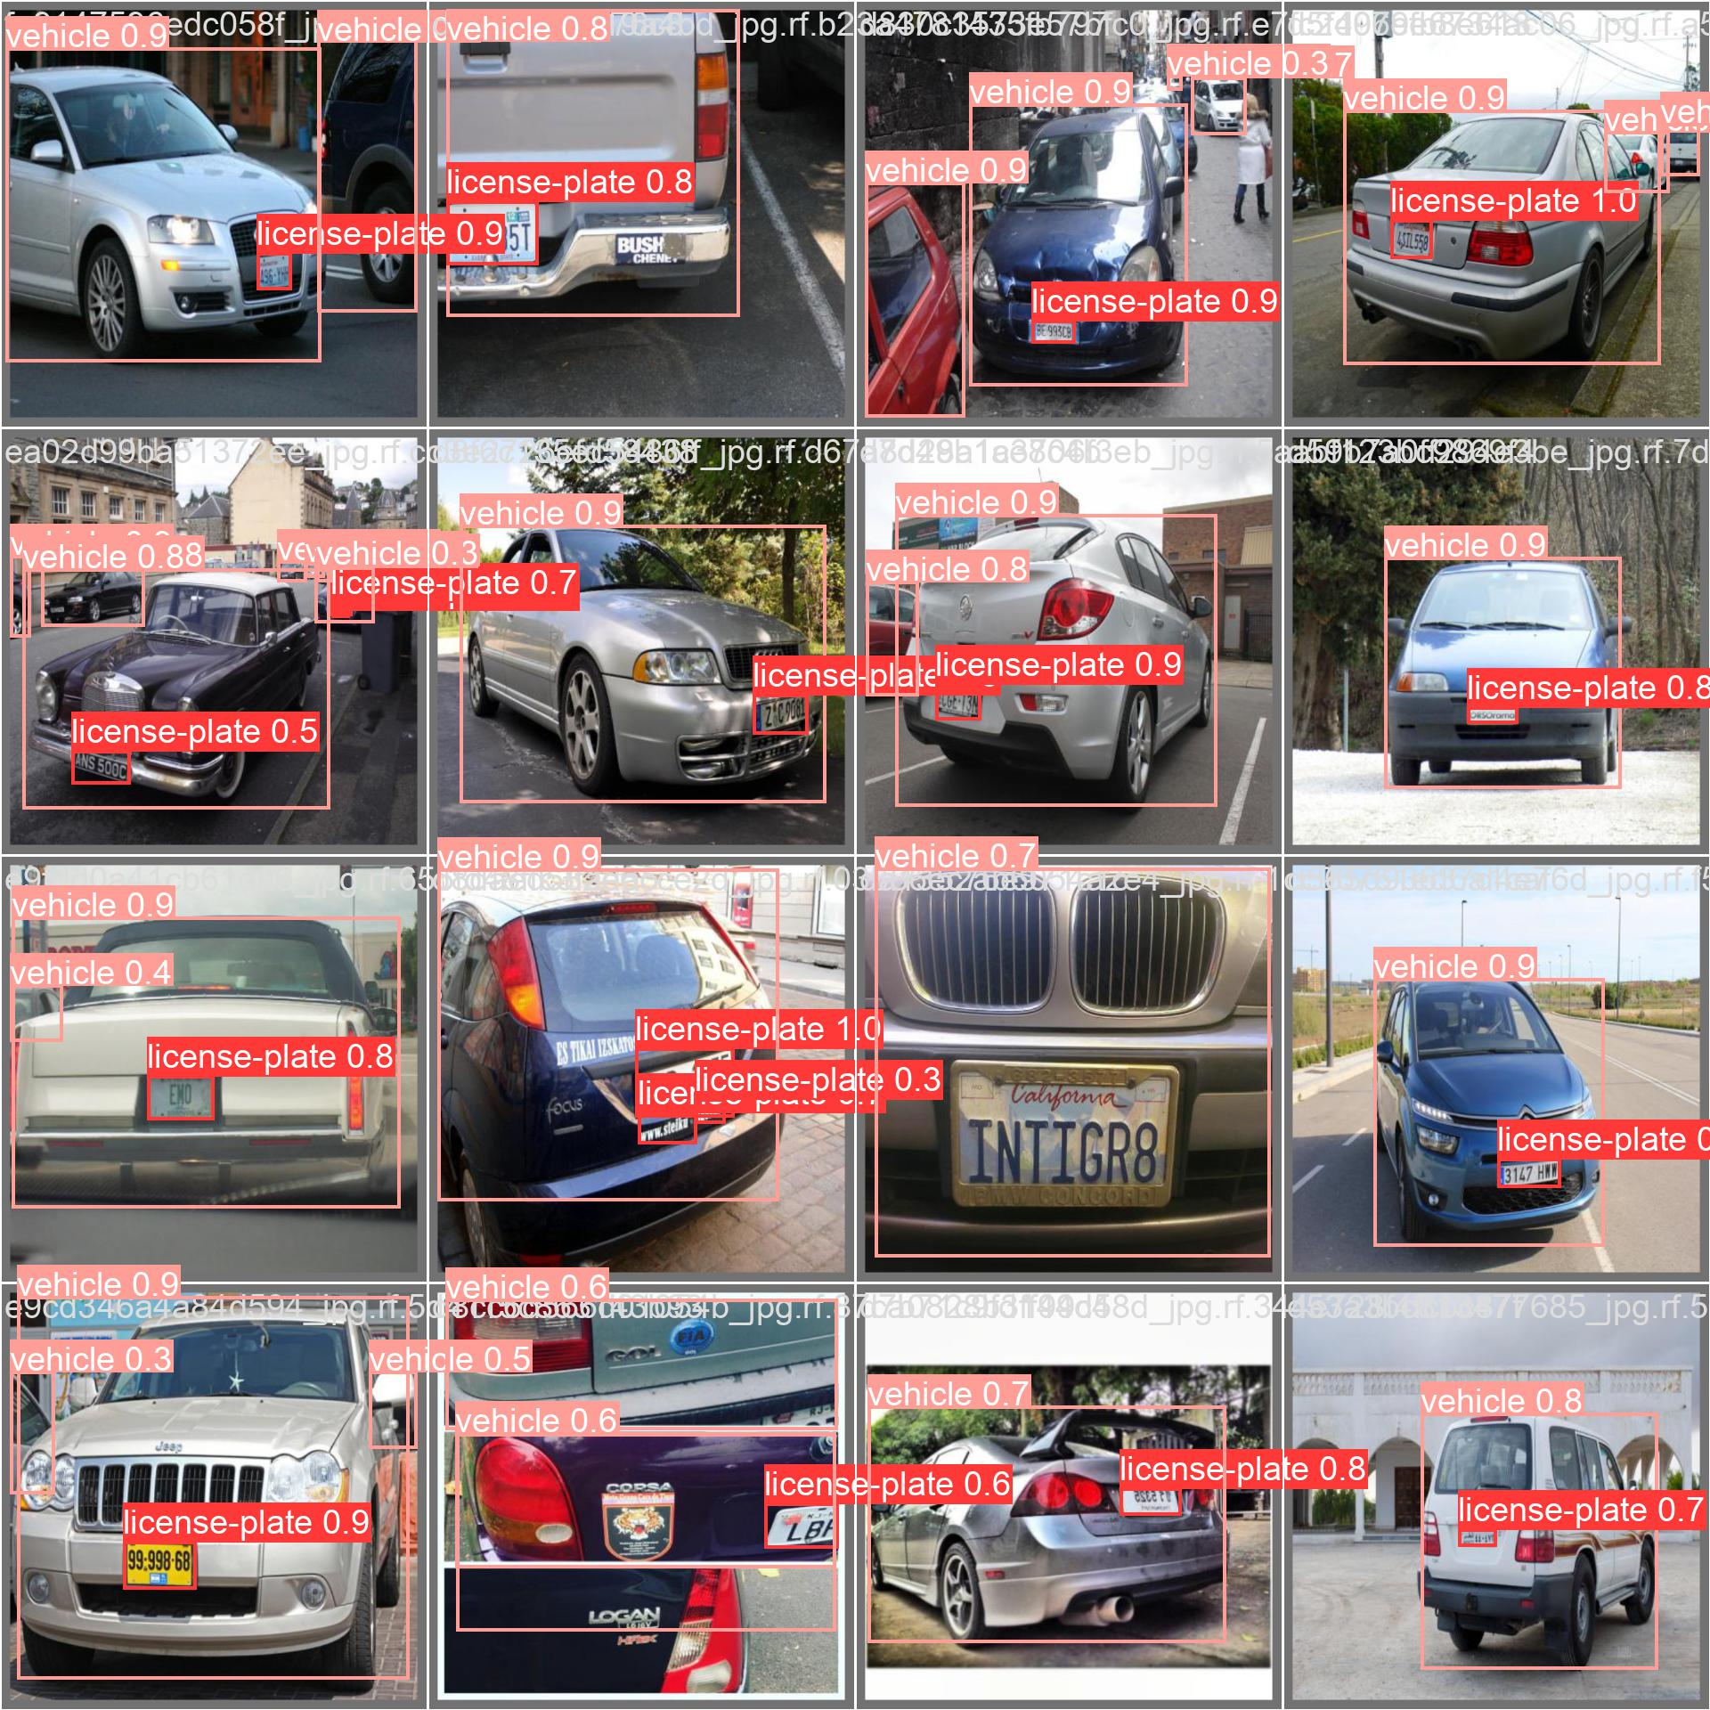

Slide 11
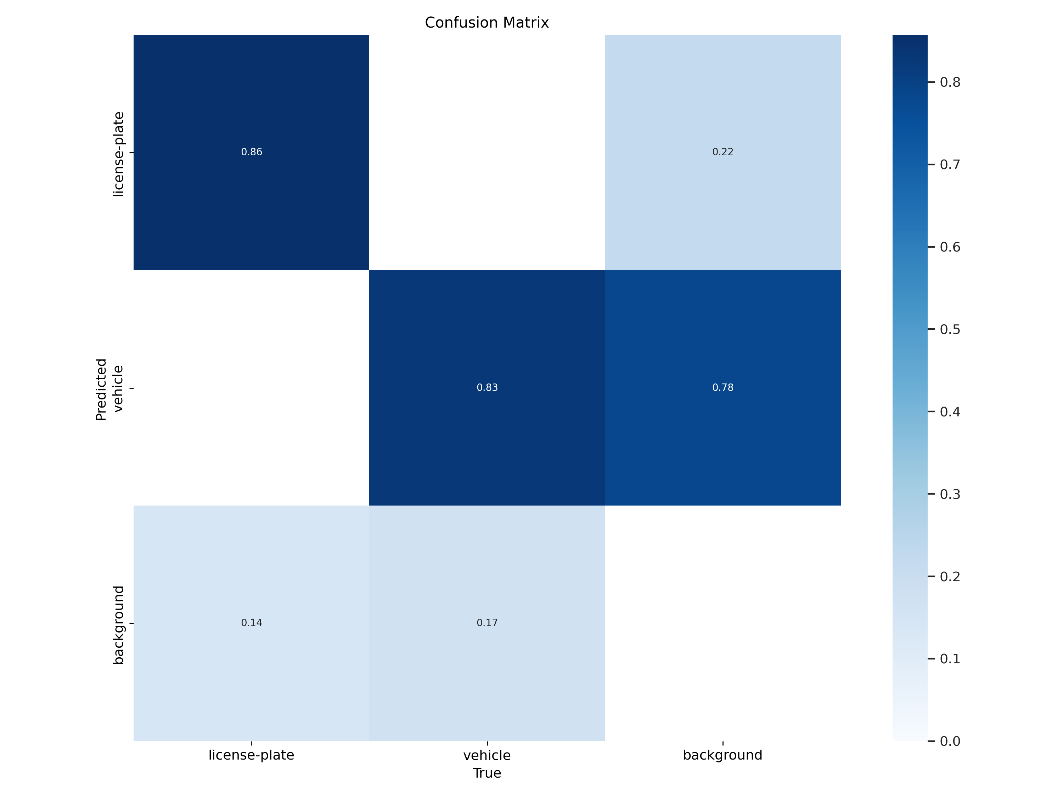
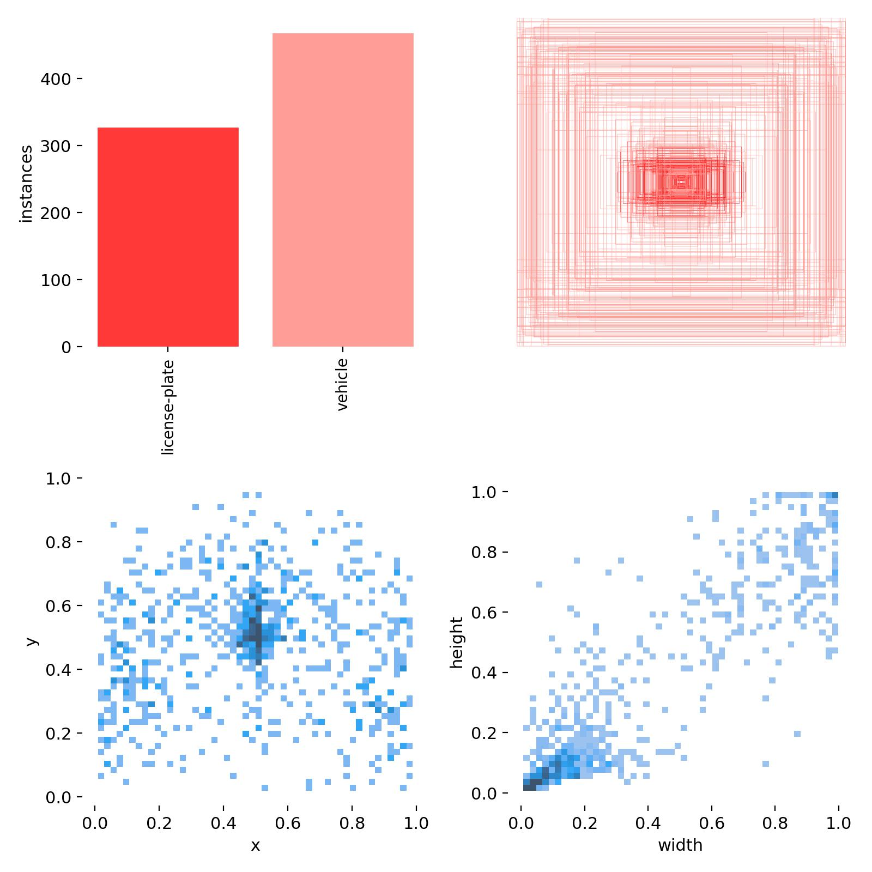

Slide 12
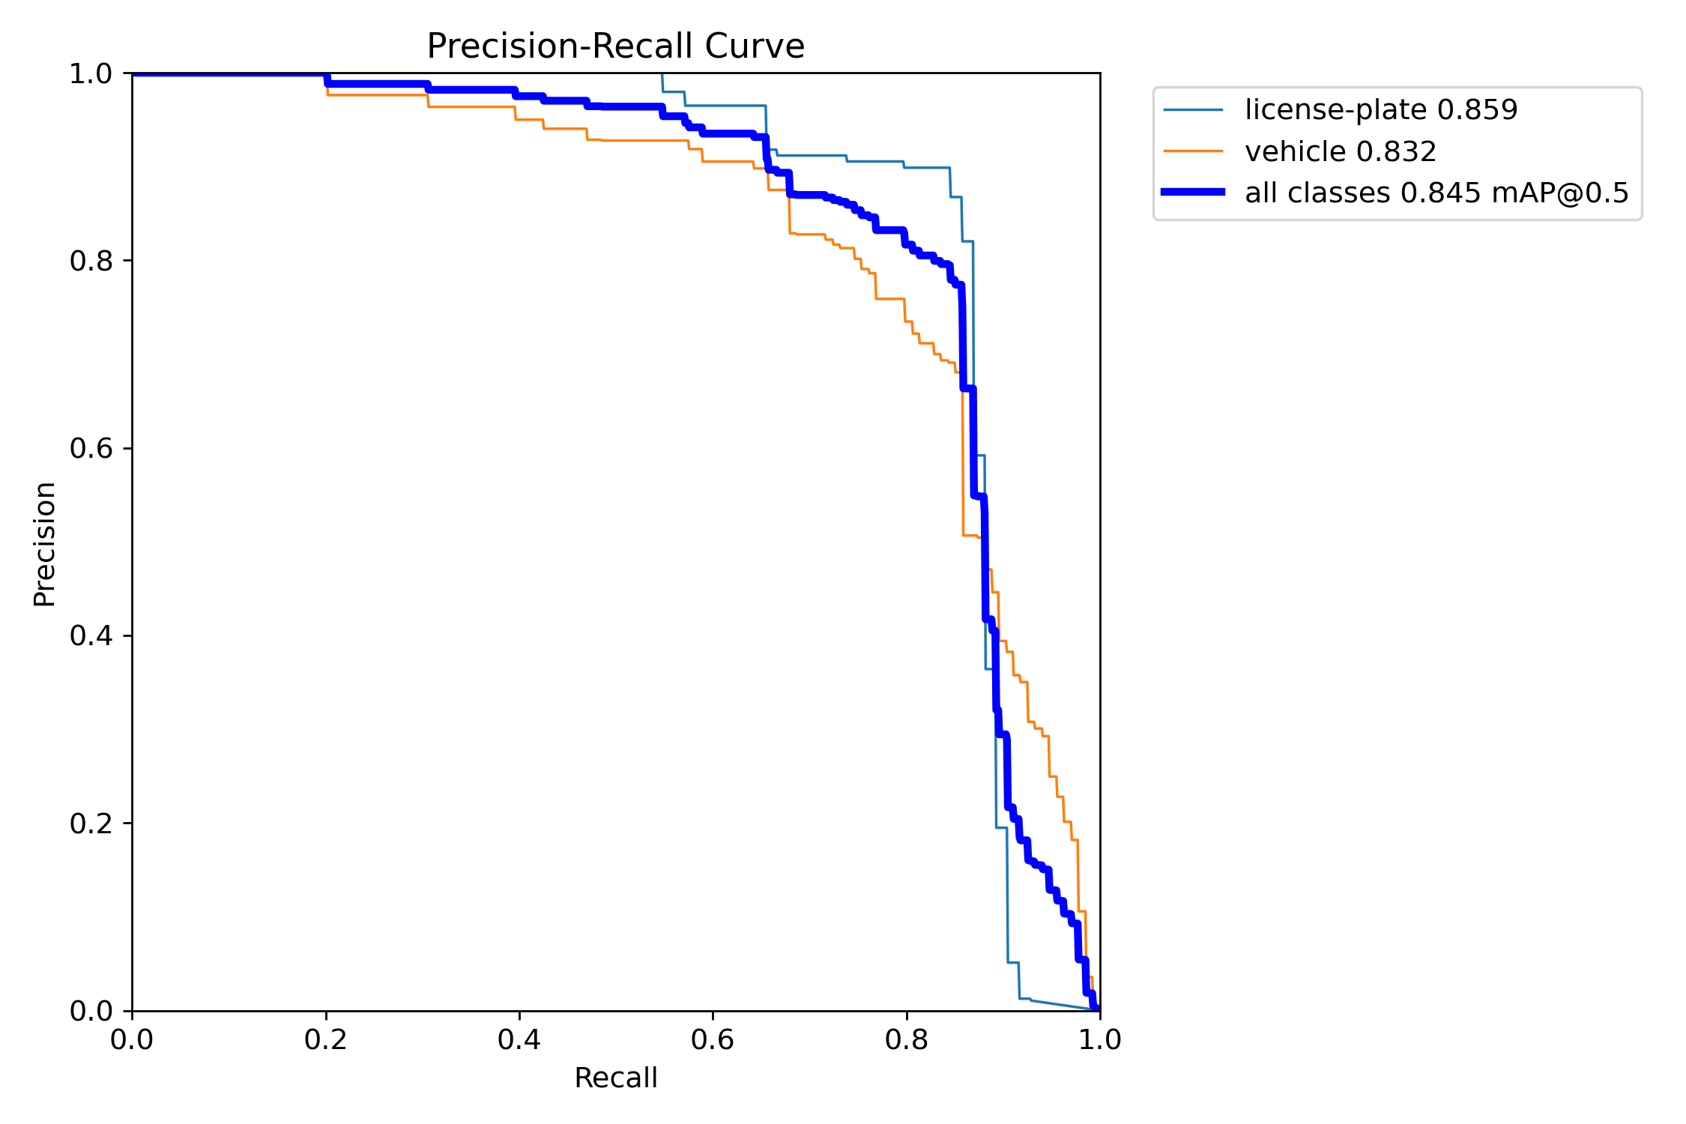
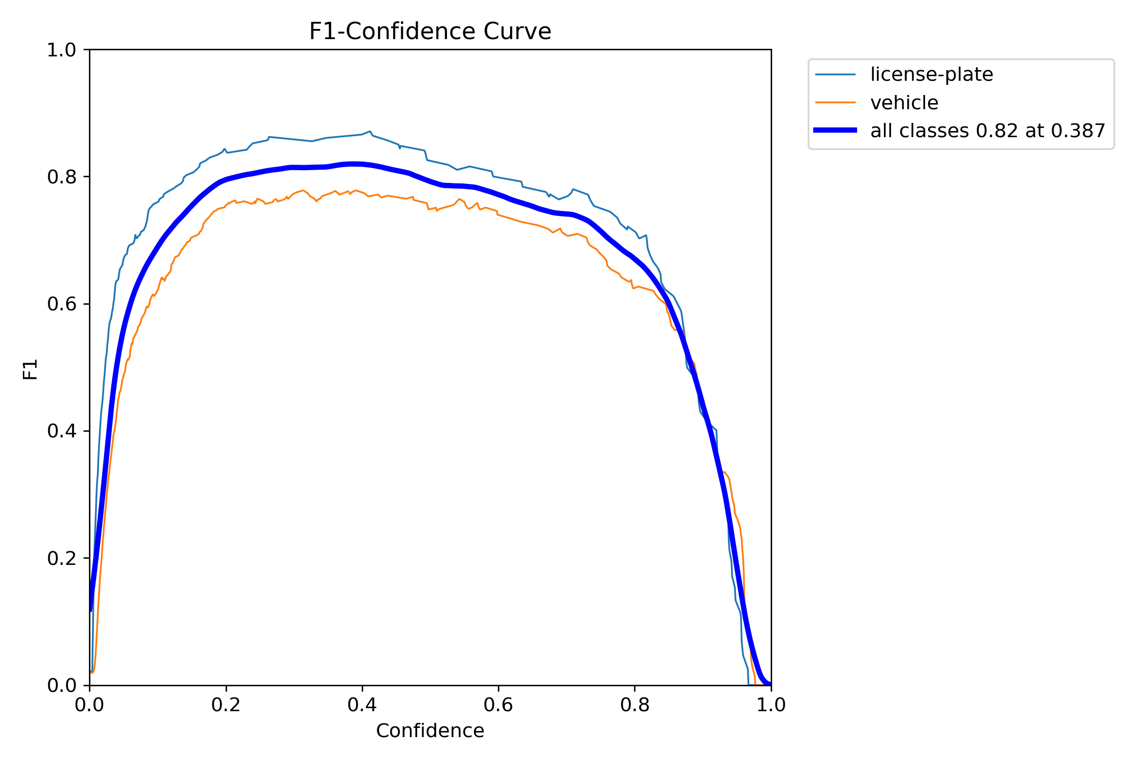

Slide 13
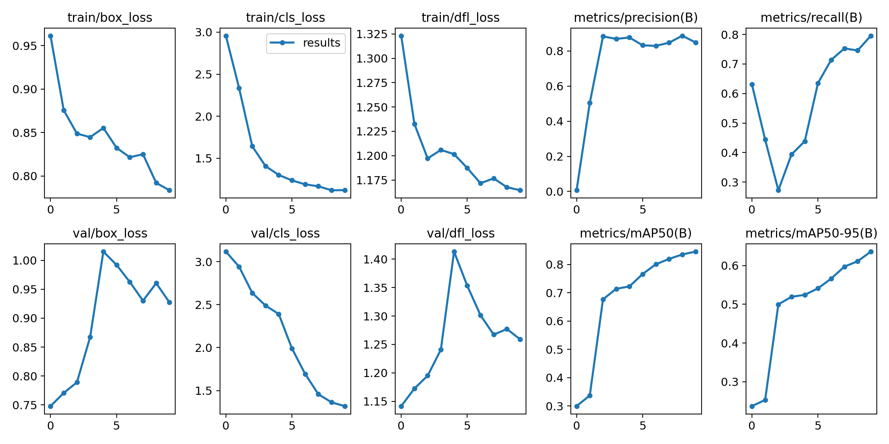

Slide 14

Methodology
The box containing the number plate is later cropped and the resultant image is as shown below

Slide 15
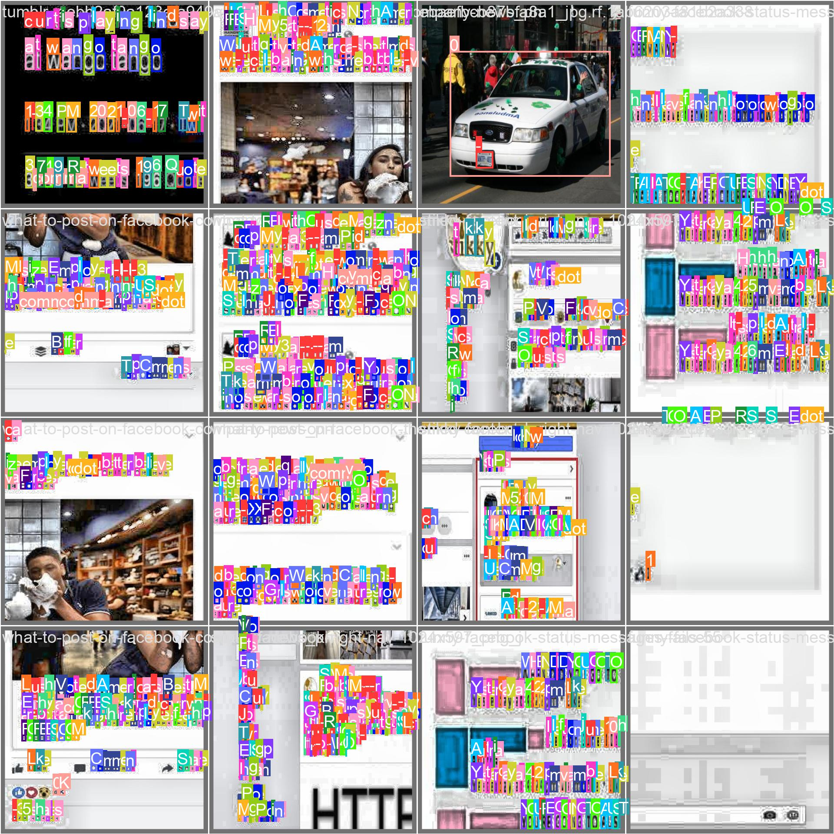
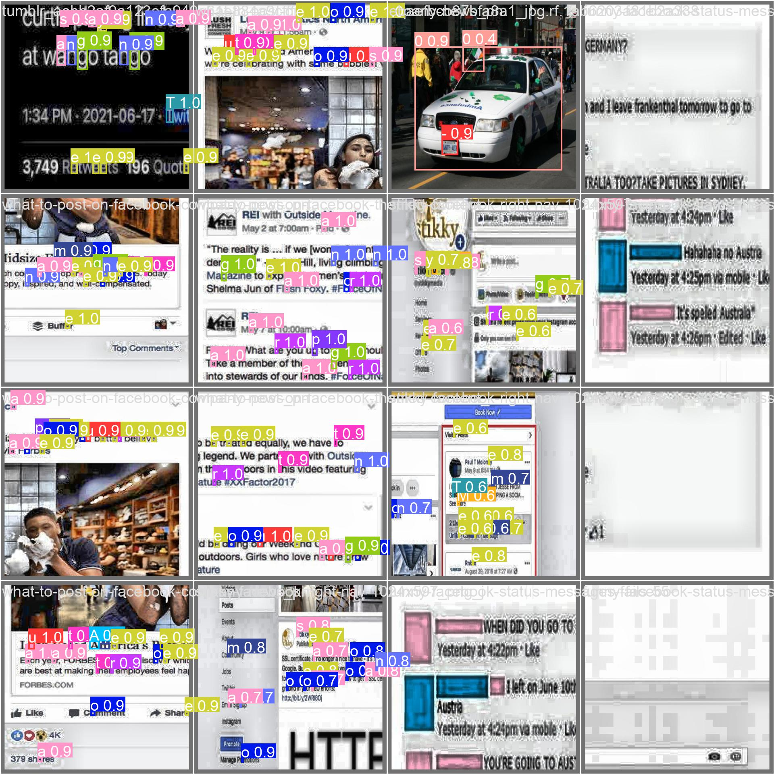

Slide 16
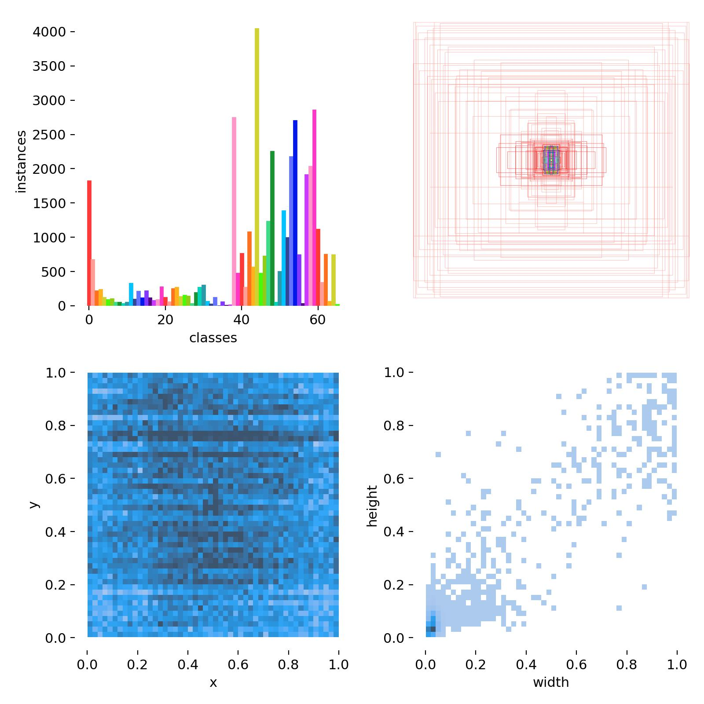
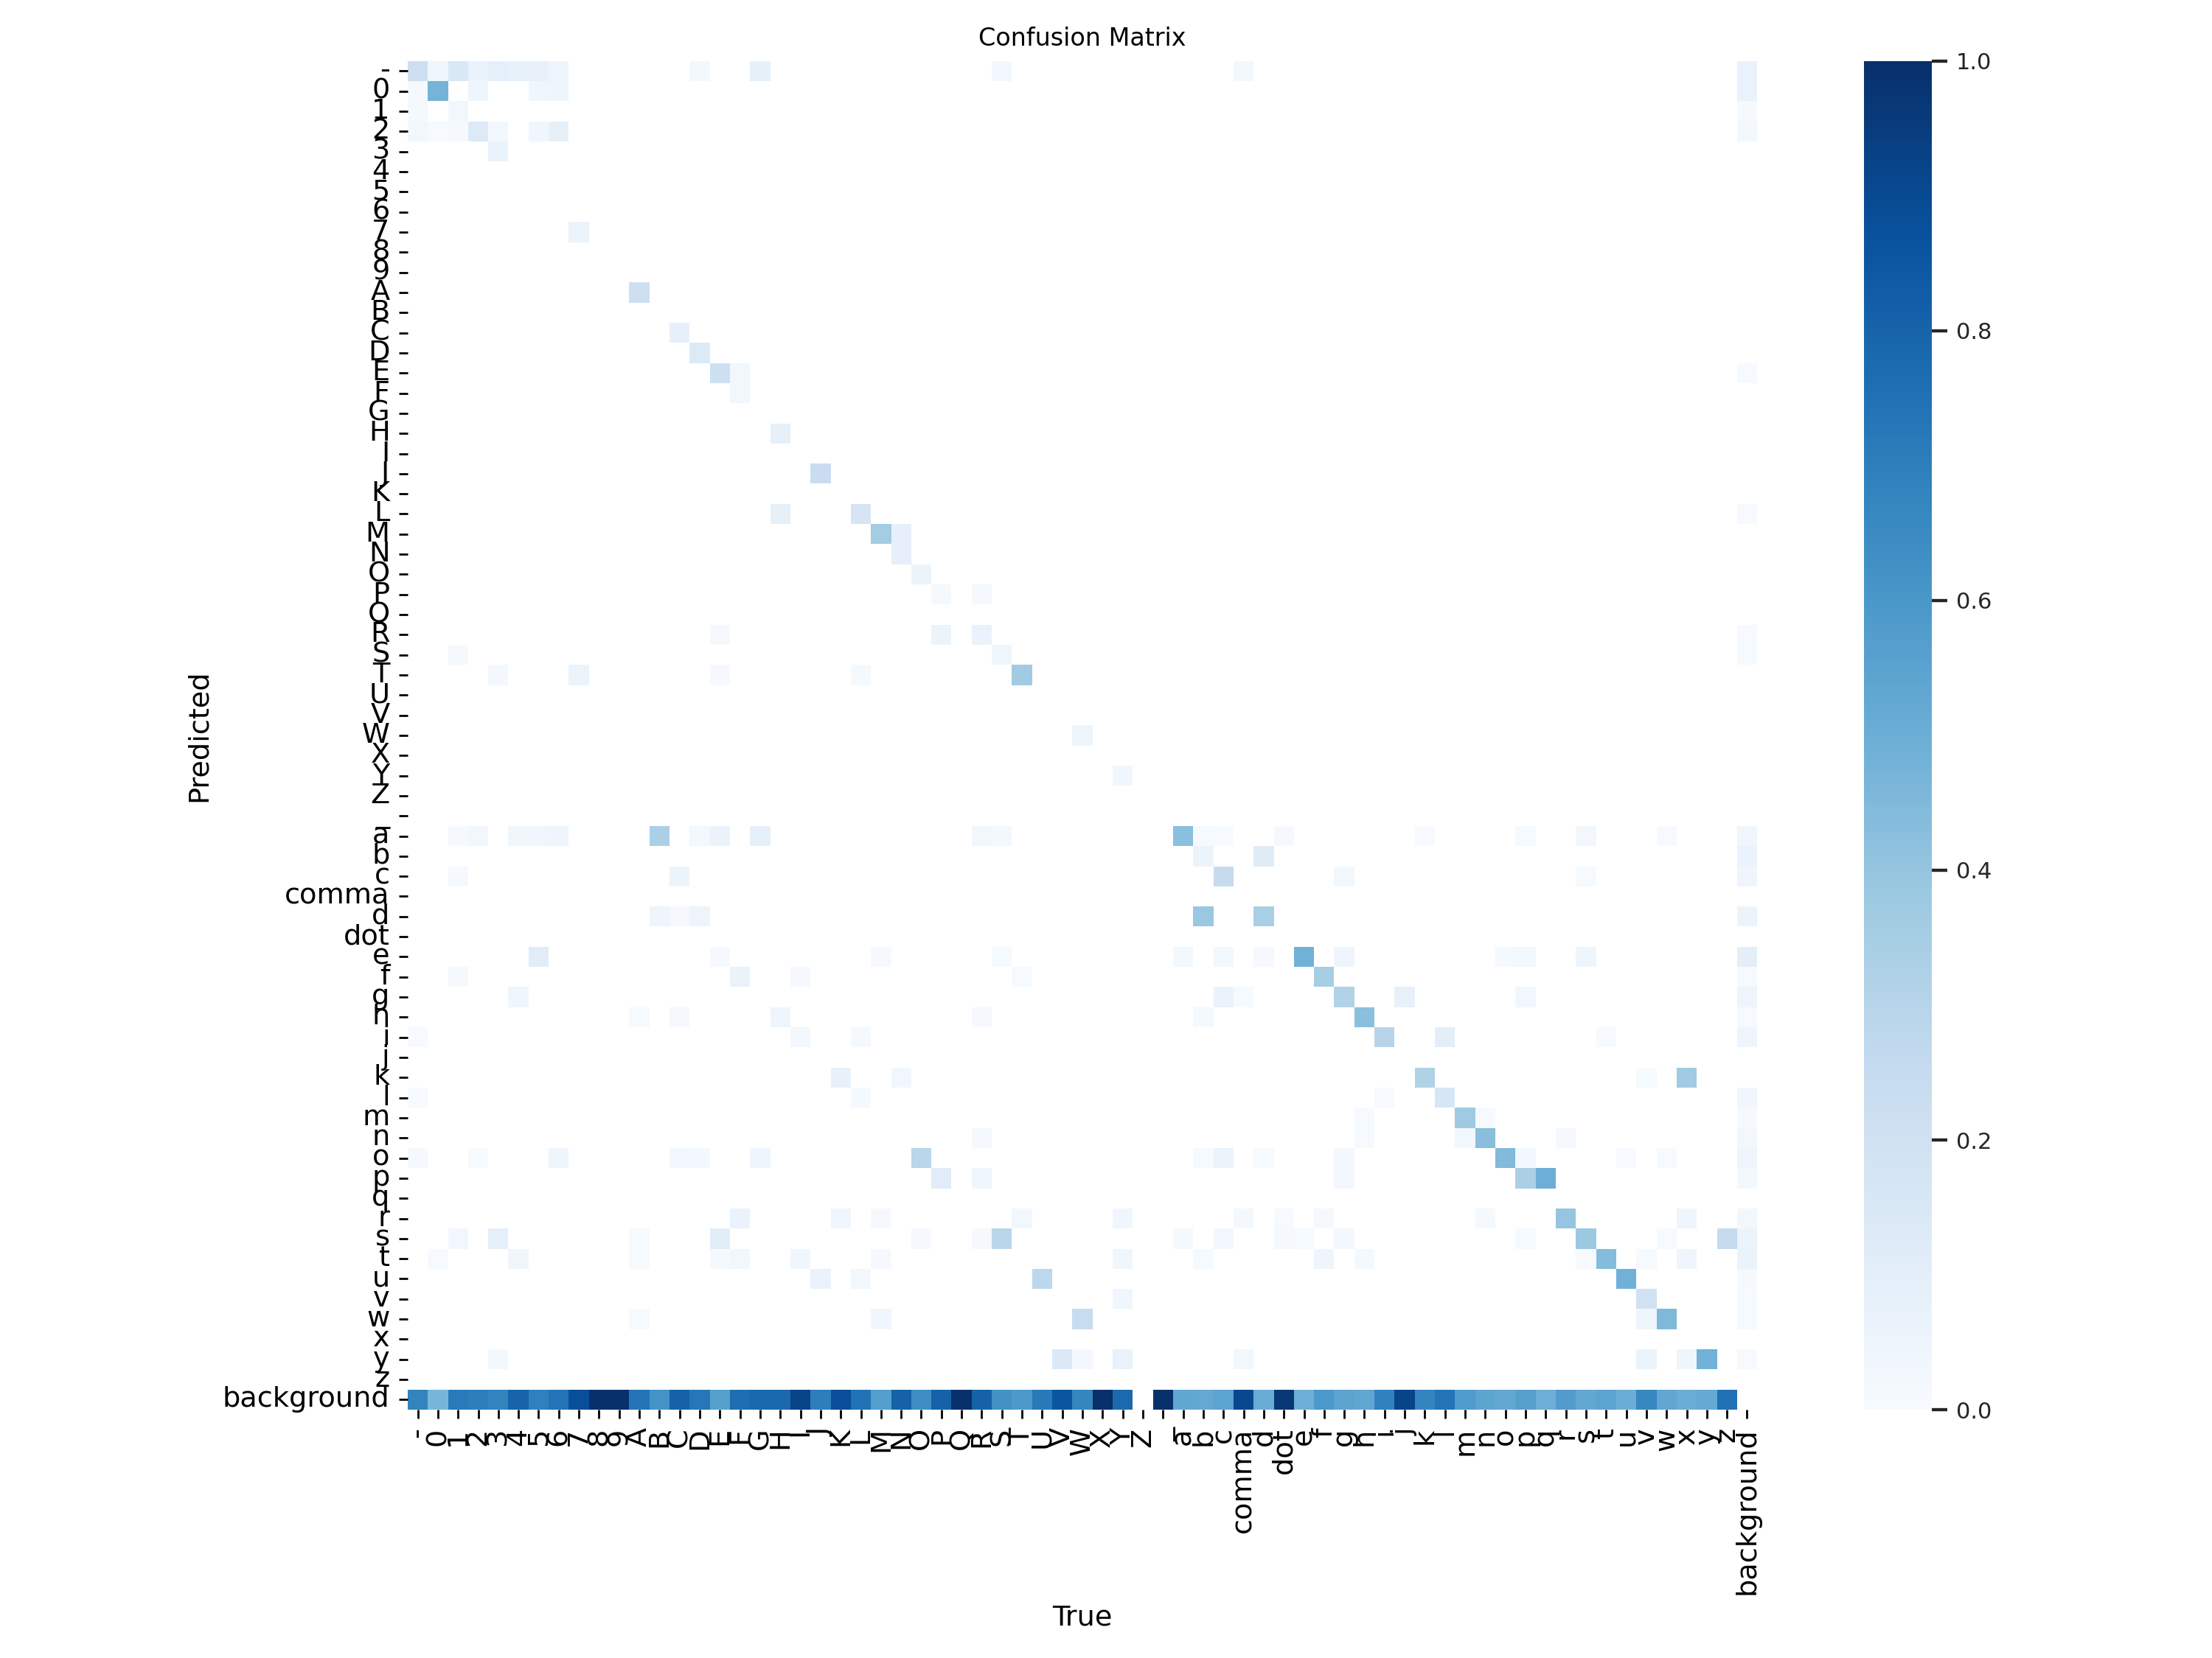

Slide 17
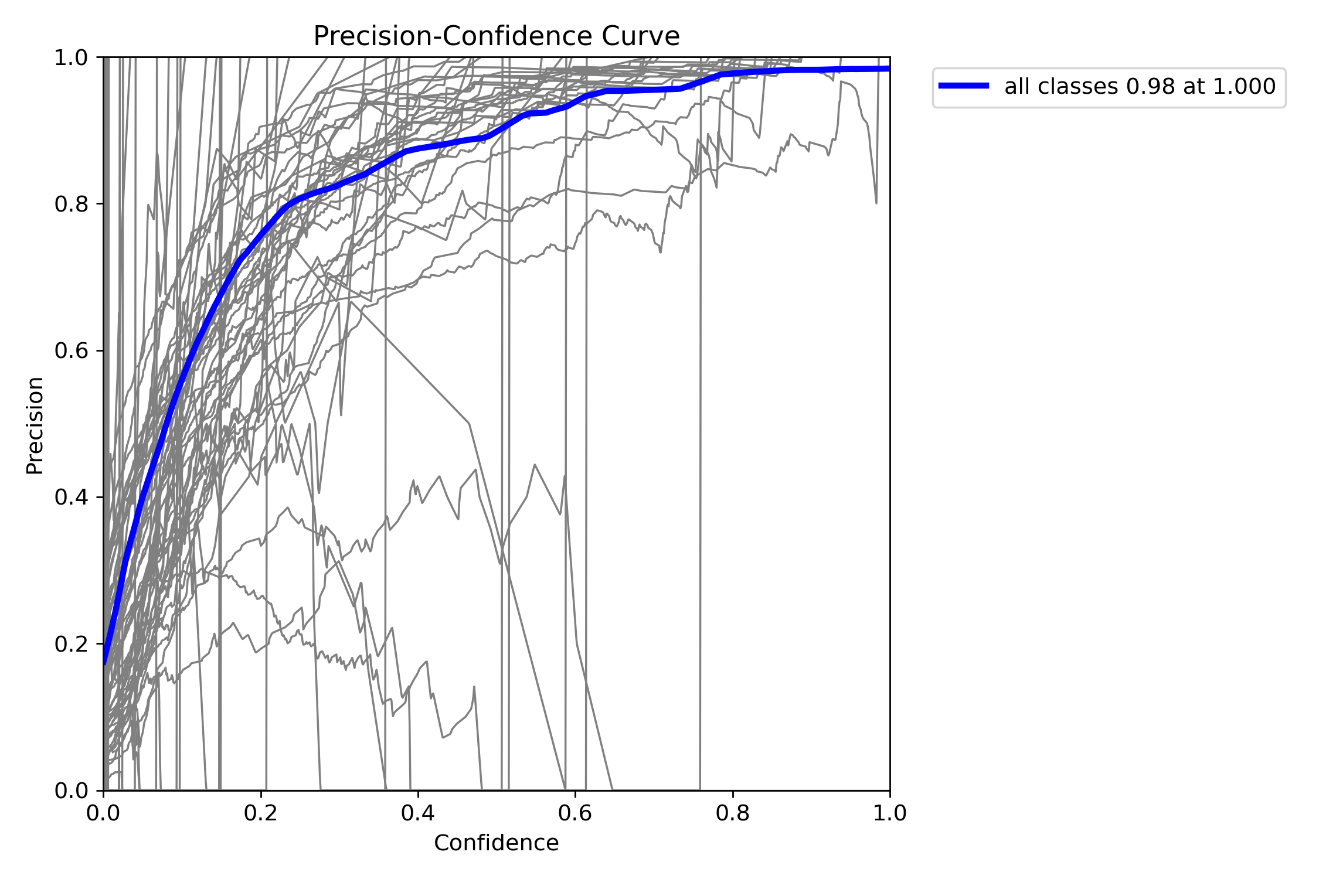
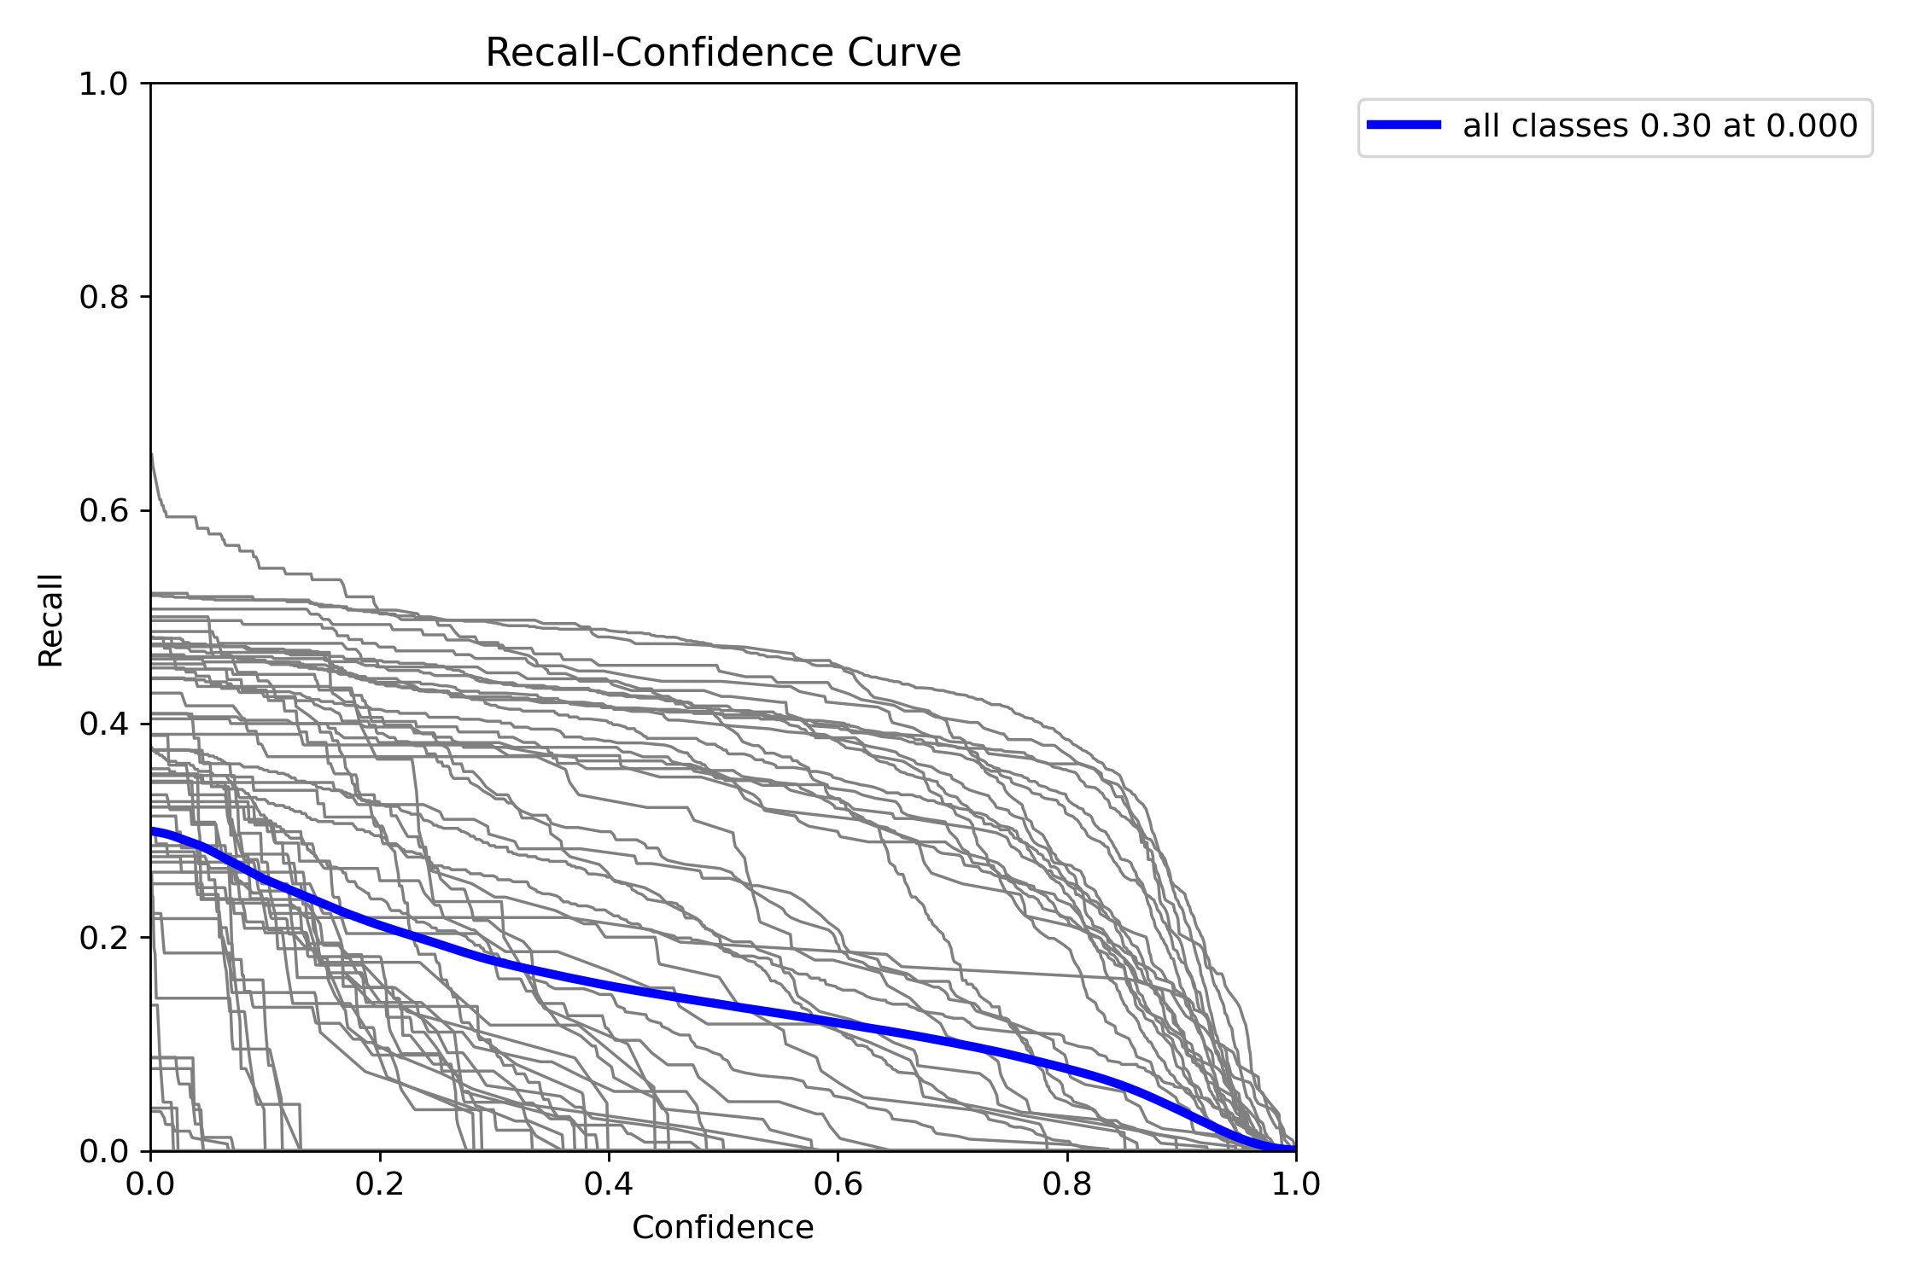

Slide 18
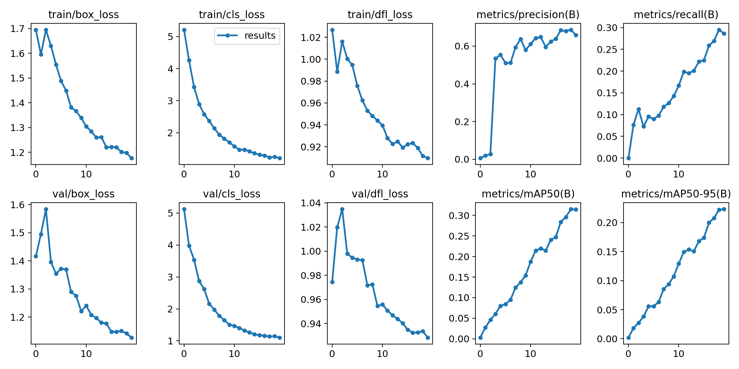

Slide 19

Methodology - Text segmentation
Then text segmentation is performed to extract the text from the number plate
The resulting output is as shown below

Slide 21
Conclusion
Though the models have taken so much time to train, they have shown extraordinary results in very less epochs.
Both the models worked almost perfectly in identifying the number plates in normal conditions. However, the models are not trained to identify number plates in critical conditions like fog, rain etc.
The resources used for training the YOLO models in this project are very limited. However, with more resources and more data, the model can easily achieve the state-of-art with less efforts.

